Slide 1
House Plant Watering Scheduler
A Comprehensive Overview of Objectives, Methods, and Results
[CSE 215, Section 11] • [Faculty : SAM3]
Presented by:
Adiyat Mahmud Neel Ashan Moni Joyaned Hossain

Slide 2
01. The Problem:
Remembering when to water different types of indoor plants

Slide 3

Defining the Challenges
The Real-World Problem (The User's Pain Point)
■
Plant Care Complexity: Indoor plants have wildly different moisture requirements. A Succulent only needs water every 14–30 days, while a Fern needs water every 3–5 days. (But for the sake of demonstration, we used 15 seconds for ferns and 7 days for succulents) Human Error: People frequently forget when they last watered a plant, leading to overwatering (root rot) or ‘under-watering’ (drying out), which are the leading causes of houseplant death. Lack of Visibility: It's hard to tell which plant is thirsty just by looking at a room full of pots until the plant is already wilting.
■
■

Slide 4
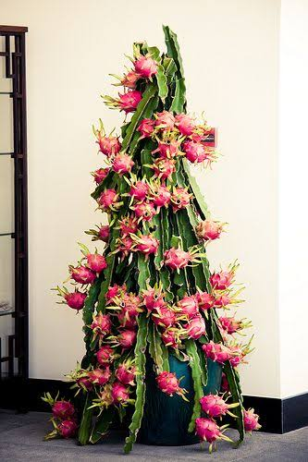
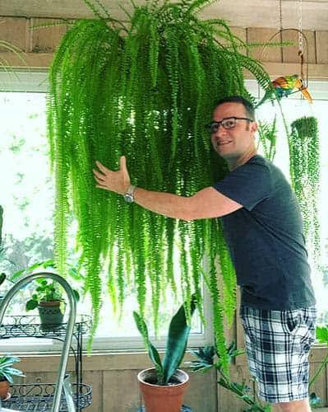
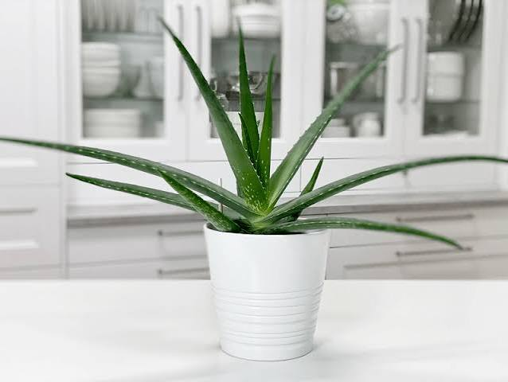
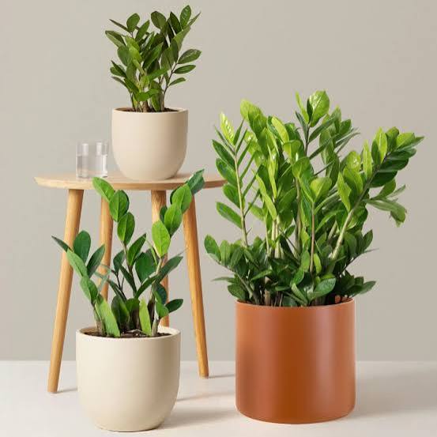
The Impact of the Problem
Indoor plants die because owners forget when they last watered, so our application solves this by using OOP to provide real-time visual alerts when a plant is thirsty depending on its type.

Slide 5
02. Proposed Solution
Our methodology, architectural design, and strategic approach to solving the identified problem.

Slide 6






The Solution Overview
Automated Visual Alerts:
Decoupled Architecture:
Replaces manual tracking with dynamic status updates; cards change color to RED automatically when a plant requires attention, and green when it doesn’t need water.
Separates underlying plant moisture rules and program code from visual presentation using Object-Oriented Principles and Java Swing.

Slide 7



Key System Components
Interface (Alertable):
Encapsulation
Decouples UI visual warnings from core plant logic.
Guarantees that any plant object can trigger standard GUI feedback
(triggerWarning() ).
Abstraction & Inheritance:
The "last watered date" variable is set to private so that it is hidden, along with some more variables.
Base abstract class Plant manages common state and behaviors. Specialized subclasses (Succulent, Fern) inherit core functionality while enforcing specific schedule logic.
GUI Infrastructure (Java Swing)
Layout Manager: Utilizing JPanel from java Swing and GridLayout to organize plant card panels.
Polymorphism
Subclasses override the checkNeedsWatering() method, and more.

Slide 8
03. Outcomes & Results
Empirical evidence, data analysis, and the final evaluation of the project's success.

Slide 9
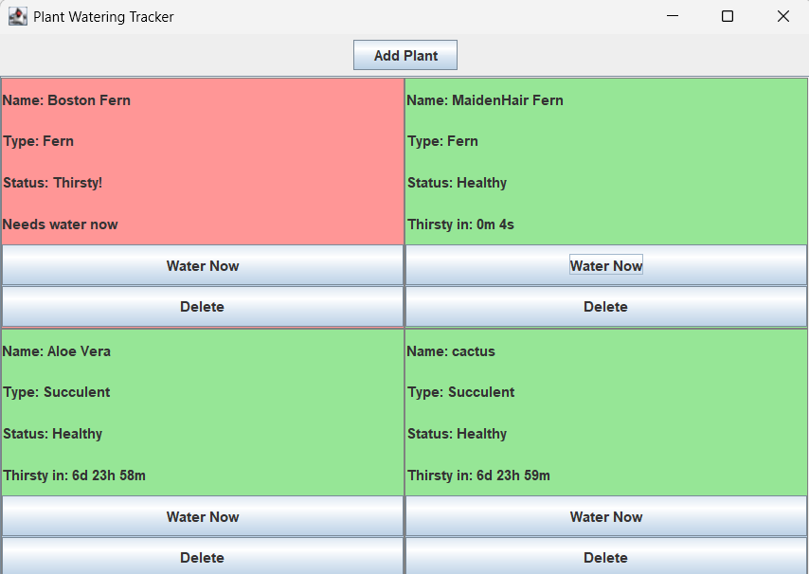
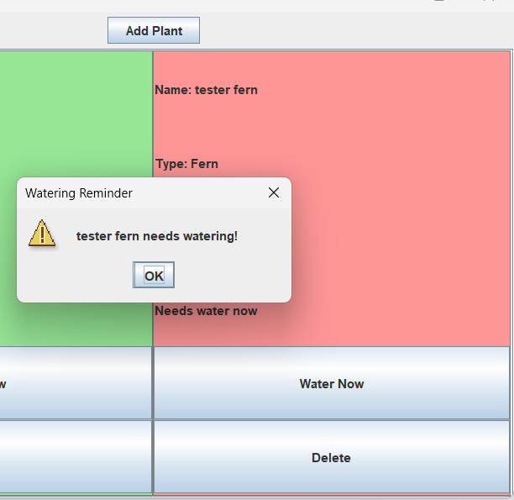
Results and Outcome
Figure: Output screen/interface showing some example plants in our program.
Figure: A warning being triggered

Slide 10
Conclusion & Future Work
Objectives Met The project successfully demonstrated the core objectives of ● Abstraction & Inheritance: Abstract class Plant. Subclasses like Succulent (water rarely) and Fern (water often). ● Polymorphism: Override a checkNeedsWatering() method based on the specific plant's hardcoded moisture requirements. ● Interface: An Alertable interface that triggers a visual warning when a plant is overdue. ● Encapsulation & Swing: Hide the "last watered date" variable. Use a Swing JPanel grid where each plant is a card that turns red (via setBackground) when thirsty.
Known Limitations While successful, the current scope was limited by the fact that this program would have to be opened all the time in a computer app/IDE. Thus, this was built to demonstrate the usage of OOP concepts, while the idea could be put into usage by using more advanced techniques.

Slide 11
Questions?
Thank you for your time and feedback.

